Slide 1
Router Initialization steps

Slide 2
Router Initialization Steps.
POST
loading Bootstrap program from ROM into RAM.
Loading IOS image into RAM.
Loading Configuration file into RAM.
  After POST is done the bootstrap program is loaded from
    ROM Into RAM to be executed
  The main job of bootstrap program is HOW to get the
    IOS loaded into RAM.

Slide 3
Router CPU and Memory
CPU
  Executes operating system instructions
RAM
  running copy of configuration file.
  routing table
  ARP cache
Read-only memory (ROM)
  POST used when router is powered up.
  Router’s bootstrap program
  Scaled down version of operating system IOS
Non-volatile RAM (NVRAM)
  Stores startup configuration. (including IP addresses, Routing protocol)
Flash memory - Contains the operating system (Cisco IOS)

Slide 4
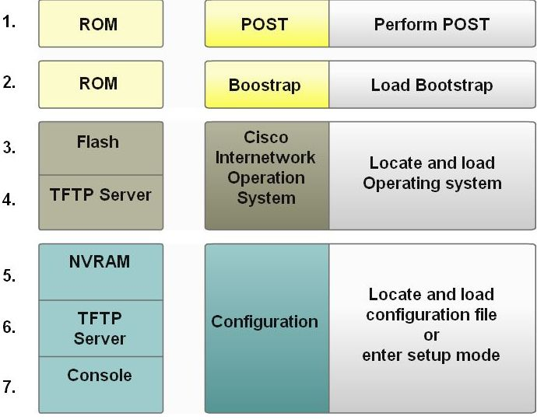
Router Bootup Process

Slide 5
Bootup Process
Step 1: POST (Power On Self Test)
Executes diagnostics from ROM on several hardware components, including the CPU,RAM, NVRAM
Step 2: Loading Bootstrap Program
Copied from ROM into RAM
Executed by CPU
Main task is to locate the Cisco IOS and load it into RAM
Step 3: Locating the IOS
Typically stored in flash memory, but it can be stored in other places such as a TFTP server.
If a full IOS image cannot be located, a scaled-down version of the IOS is copied from ROM
This version of IOS is used to help diagnose any problems and to try to load a complete version of the IOS into RAM.

Slide 6
Boot up Process
Step 4: Loading the IOS
Some of the older Cisco routers ran the IOS directly from flash
Current models copy the IOS into RAM for execution
Might see a string of pound signs (#) while the image decompresses.
Step 5: Locating the Config File
Bootstrap program searches for the startup configuration file (startup-config), in NVRAM.
This file has the previously saved configuration commands and parameters,
Step 6: Loading the Config File
If a startup configuration file is found in NVRAM, the IOS loads it into RAM as the running-config file and executes the commands.
If the startup configuration file cannot be located, prompt the user to enter setup mode

Slide 7
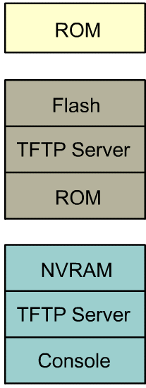
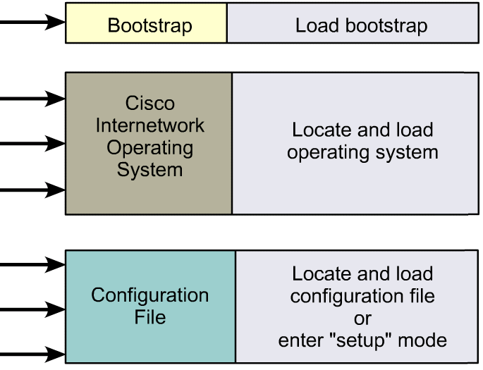
Step in Router Initialization

Slide 8
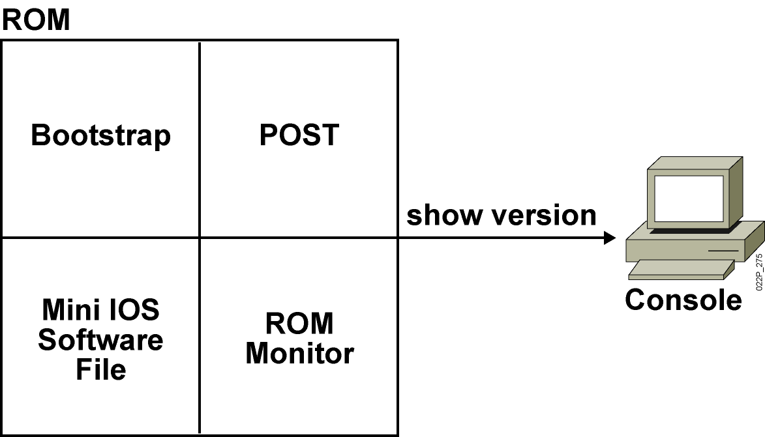
ROM Functions
Contains microcode for basic functions
Notes:
Note: Mini Cisco IOS is the Rxboot mode.
One use of the ROM monitor is for password recovery. From ROM monitor, you can set the config register to 0x2142 so the NVRAM will be ignored during startup.

Slide 9
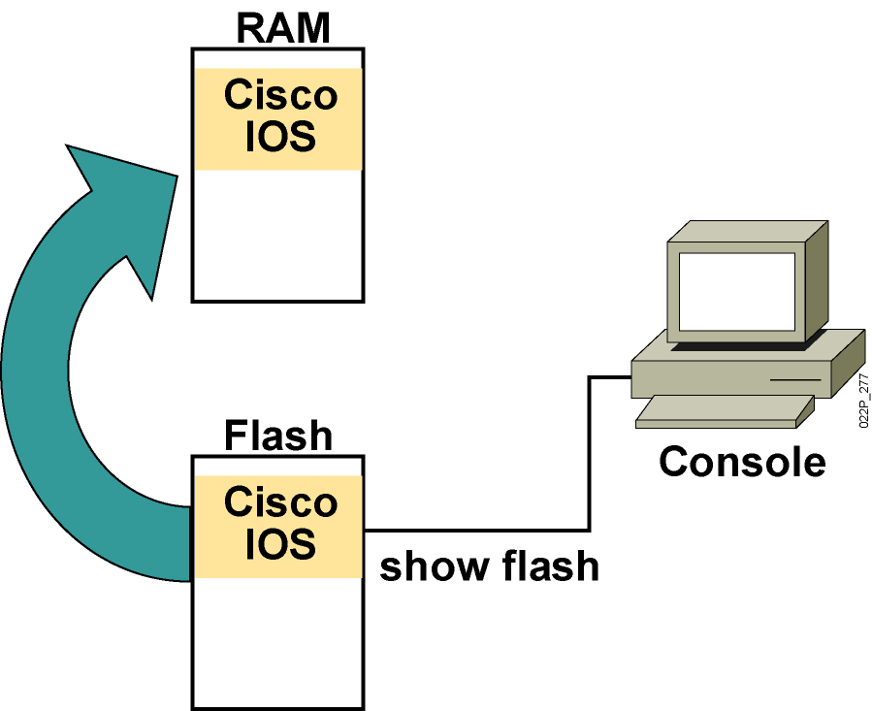
Loading the Cisco IOS Image from Flash Memory
The flash memory file is decompressed into RAM.
Notes:
Note: The 2500 series routers do not operate this way. The 2500 series routers normally run Cisco IOS from Flash. The Cisco IOS in Flash is not compressed but it is relocatable. Relocatable means the Cisco IOS image can be run from Flash or from RAM.
The 2500 can run from RAM if you use the boot system tftp command to boot the Cisco IOS image.
The Rxboot mode is also run from RAM on the 2500 routers.

Slide 10
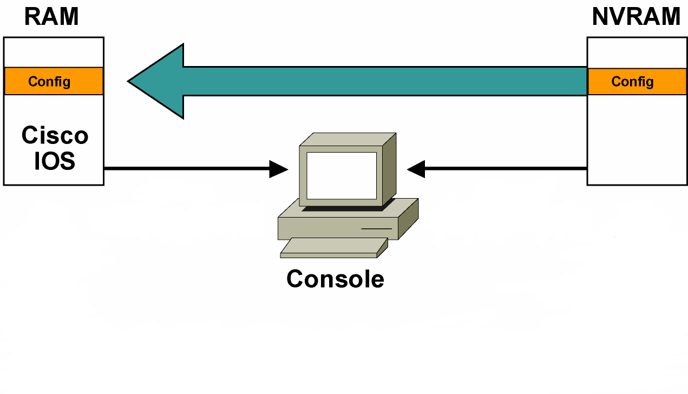
Loading the Configuration
  Load and execute the configuration from NVRAM.
Notes:
Emphasize: Using the default config register value (0x2102), the router will load the config from NVRAM at startup.

Slide 11
SECTION SUMMARY
Router hardware components
Cisco Software components
Router memory
Router Initialization Steps.

Slide 12
Router Access

Slide 13
ROUTER ACCESS METHODS
Directly using the console port
  No configuration needed on the router
Telnet – over the network
  Network connection
  Network configuration on both ends (IP address, subnet mask, etc.)
  Telnet password configured on router
Modem (AUX.PORT on the router)
Web access

Slide 14
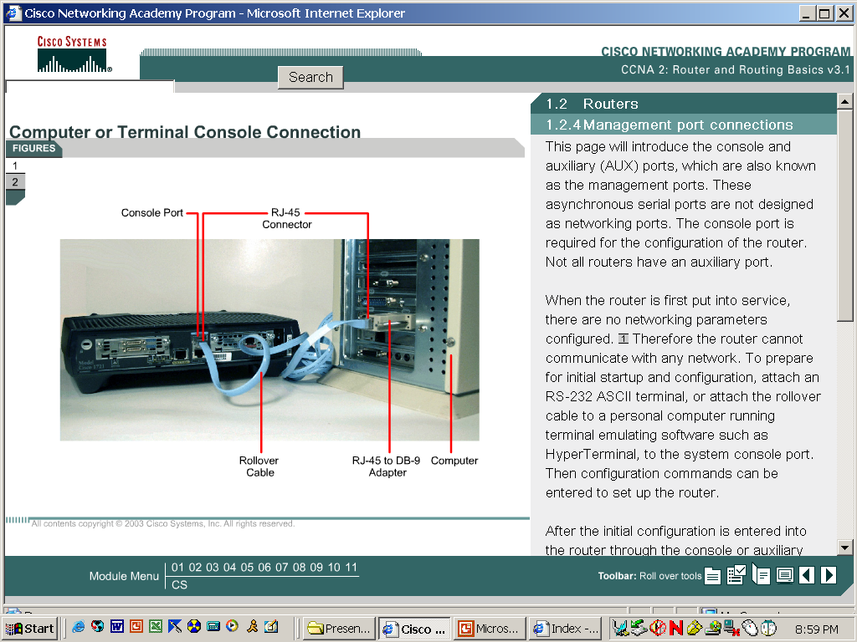
Console
The console port is a management port that provides out-of-band access to a router.
Examples of console use are:
  The initial configuration of the network device
  Disaster recovery procedures and troubleshooting where remote access is not possible
  Password recovery procedures

Slide 15
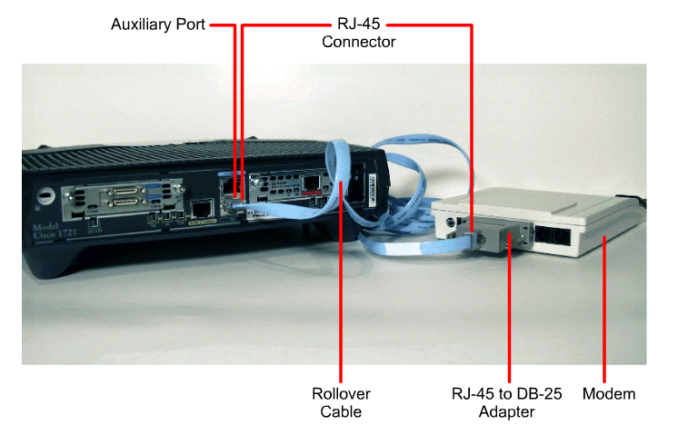
AUXILIARY

Slide 16
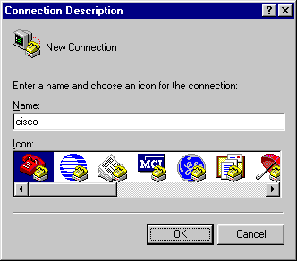
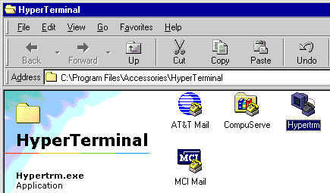
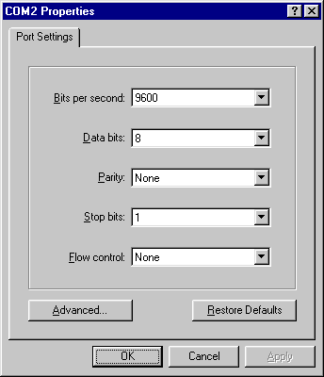
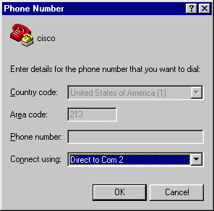
Using HyperTerminal
Settings
Match serial port on PC

Slide 17
AUX
Another way to establish a CLI session remotely is via a telephone dialup connection using a modem connected to the router's AUX port.
Similar to the console connection, this method does not require any networking services
The AUX port can also be used locally, like the console port.
Generally, the only time the AUX port is used locally instead of the console port is when there are problems using the console port

Slide 18
Telnet and SSH
Unlike the console connection, Telnet sessions require active networking services on the device.
A host with a Telnet client can access the z sessions running on the Cisco device.
The Secure Shell (SSH) protocol is a more secure method for remote device access.
SSH client software is not provided by default on all computer operating systems.

Slide 19
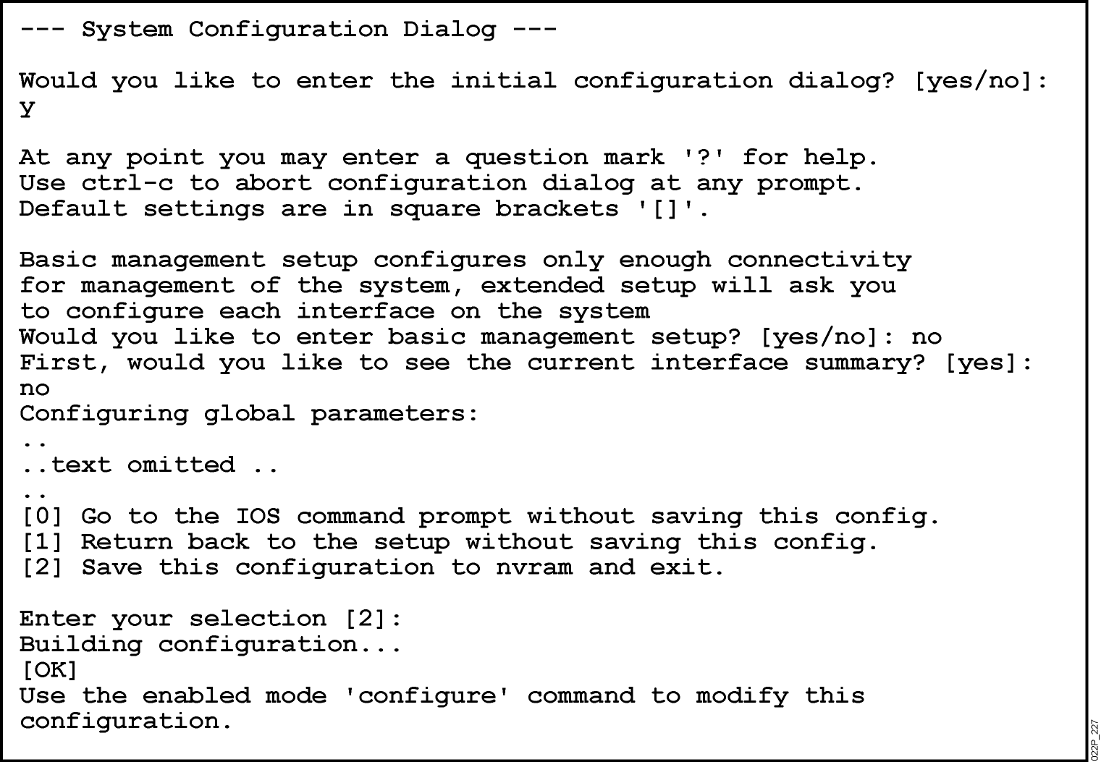
Setup mode
- Permit the administrator to install a minimal configuration for a router ( appeared if no saved configuration , Ctrl-C to skip )
Notes:
Purpose: This slide describes the console output on the Catalyst 1900 switch during startup.
Emphasize: If a POST fails, a corresponding console message will be displayed indicating the POST failure. In this slide, the switch started up without any POST error.
From the User Interface menu, select K to access the command-line interface.
In this class, we will only discuss the Catalyst 1900 CLI configuration method.

Slide 20
Setup Mode
The router will enter setup mode when:
  The contents of NVRAM have been erased with the “erase start” command
  When the router is “out of the box” and has not been initially configured
  After deleting the backup configuration and reloading the router
You can make the router enter setup mode by entering:
  Router#setup

Slide 21
SECTION SUMMARY
ROUTER ACCESS METHODS
  Console , AUXILIARY , TELNET , WEB ACCESS
Using HyperTerminal
Telnet and SSH
Setup mode

Slide 22
CLI First look

Slide 23
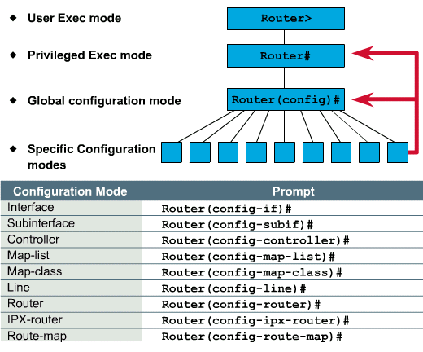
ROUTER Modes
end
exit

Slide 24
User EXEC Mode
The user EXEC mode allows only a limited number of basic monitoring commands.
This is often referred to as a view only mode.
The user EXEC level does not allow any commands that might change the configuration of the router.
The user EXEC mode can be identified by the > prompt.

Slide 25
Privileged EXEC Mode
The privileged EXEC mode provides access to all router commands.
This mode can be configured to require a password.
Configuration and management commands require that the network administrator be at the privileged EXEC level.
Global configuration mode and all other more specific configuration modes can only be reached from the privileged EXEC mode.
The privileged EXEC mode can be identified by the # prompt.

Slide 26
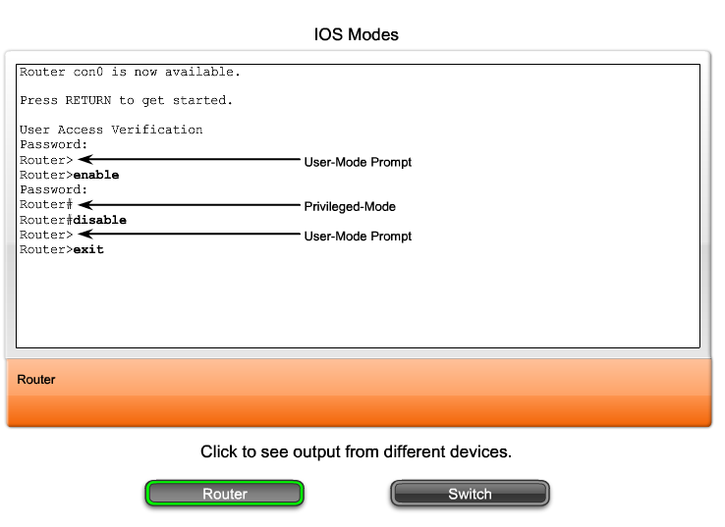
Moving between the User EXEC and Privileged EXEC Modes

Slide 27
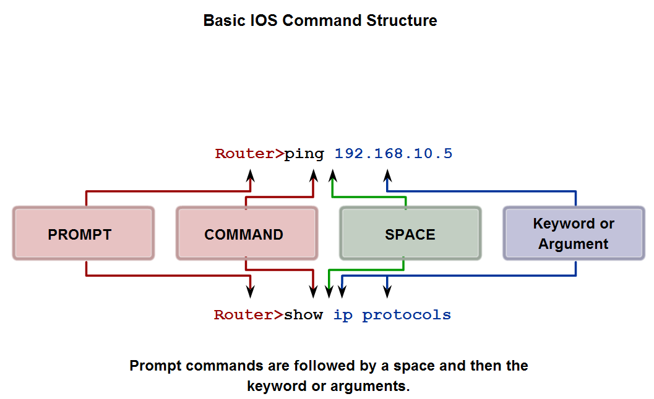
Basic IOS command structure
Identify the basic command structure for IOS commands

Slide 28
Using CLI help
Identify the types of help and feedback available while using IOS and use these features to get help, take shortcuts and ascertain success

Slide 29
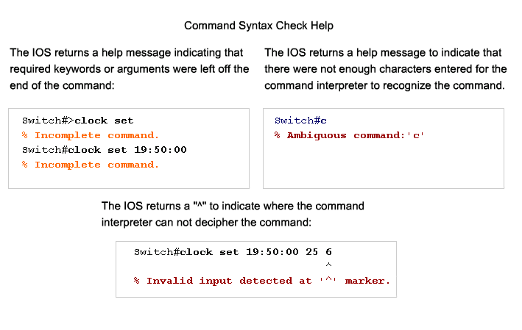
Using CLI help

Slide 30
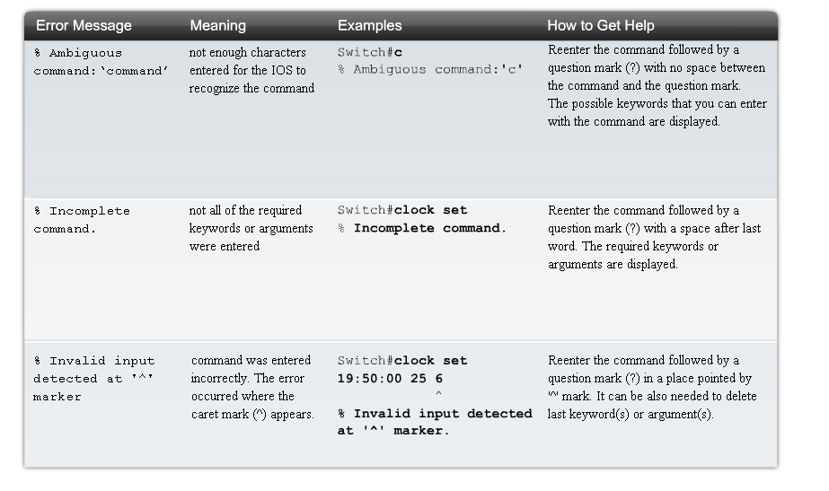
Using CLI help

Slide 31
Abbreviated commands (Router and Switch)
Router# sh inter
Same as
Router# show interfaces

Slide 32
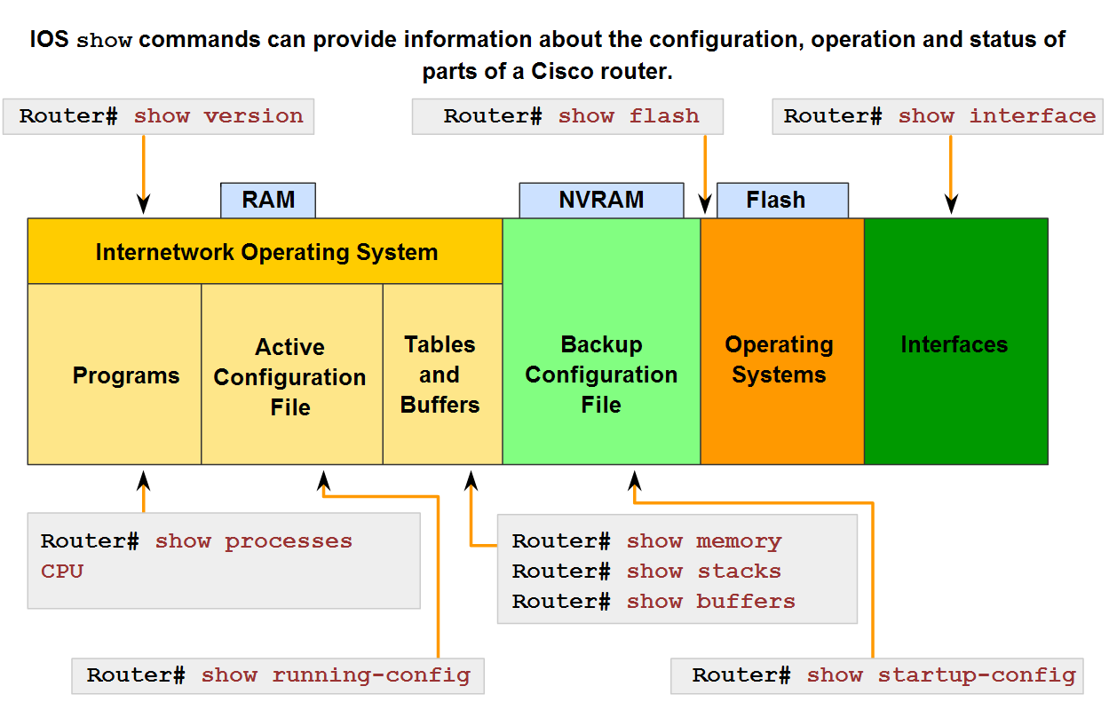
IOS "examination" commands
Identify the purpose of the show command and several of its variations

Slide 33
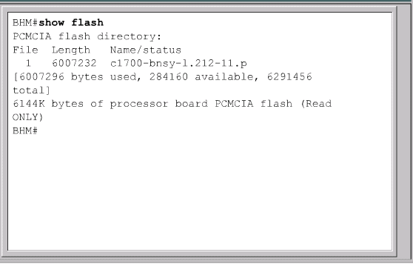
This command will show all of the Cisco IOS image files – not just the one that the router booted from.
Might compare to a directory listing

Slide 34
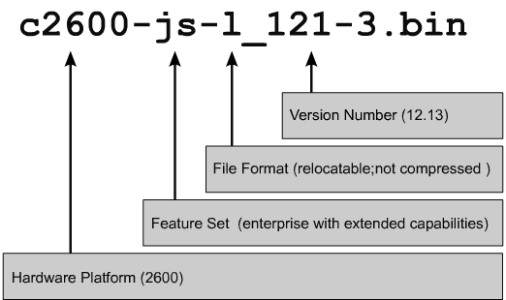
IOS software and features
The naming convention for the different Cisco IOS releases contains three parts:
  The platform on which the image runs
  The special features supported in the image
  Where the image runs and whether it has been zipped or compressed

Slide 35
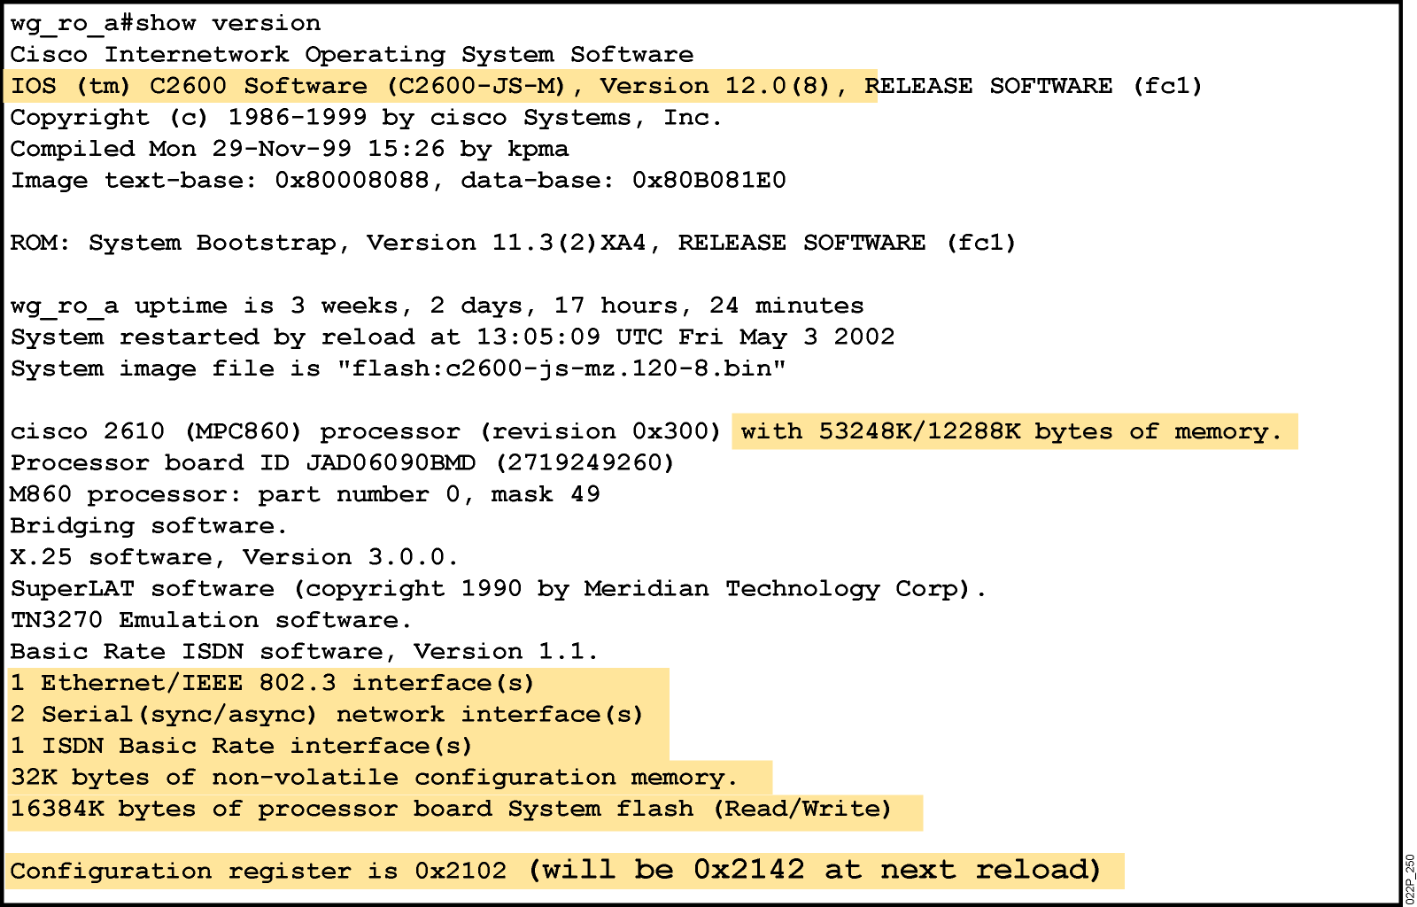
show version Command
IOS version
Router up time
System image file & location
Last restart method
Number & type of interfaces on the router
NVRAM SPACE
FLASH SPACE
Configuration register setting

Slide 36
show version Command

Slide 37
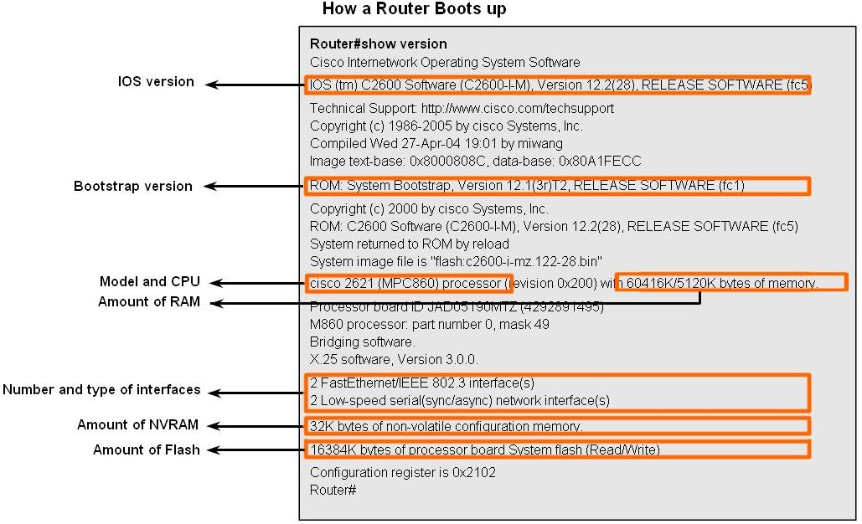
Verify the router boot-up process

Slide 38
IOS loading control
Router use the following logic to load an IOS
Load minimized IOS from ROM based on the config. Register setting for 0x2101 or 0x2100
Load the IOS based on the configuration of the bootsystem command in the start –up config. File
Load the first IOS file in the flash
Load the IOS file from TFTP server
Load minimized IOS from ROM

Slide 39
Boot system command
- beside the configuration register you can use the boot system command to force booting location.
Router(config)# boot system flash
Router(config)# boot system rom
Router(config)# boot system tftp

Slide 40
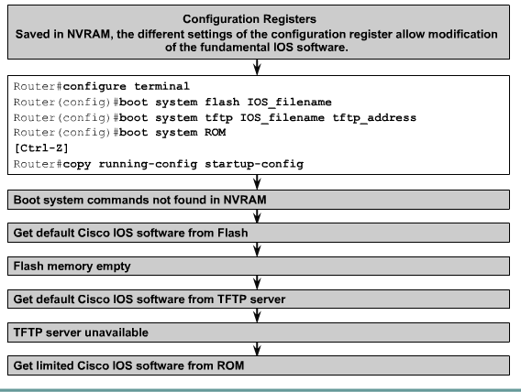
Locating and Loading the IOS Image

Slide 41
Editing Commands
  <Ctrl><A> Move to beginning of line
  <Ctrl><E> Move to the end of the line
  <Esc><B> Move back one word
  <Ctrl><F> Move forward one character
  <Ctrl><B> Move back on character
  <Esc><F> Move forward one word
  $ Sign means that the line has scrolled to the left
  To disable enhanced editing mode, type terminal no editing at the privileged EXEC mode prompt.

Slide 42
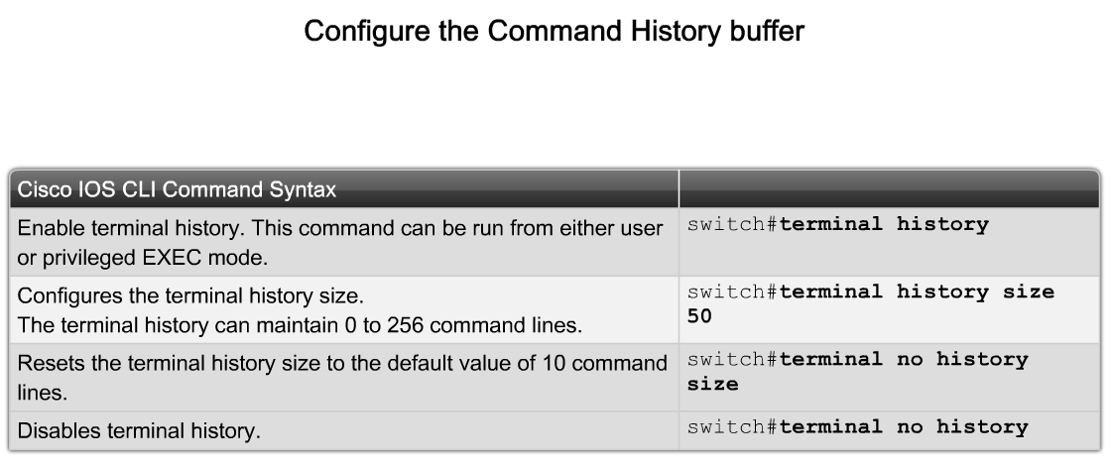
Router Command History

